Slide 1
Weather Trend Forecasting with Ridge Regression
Predicting Next-Day Temperature(degree Celsius)
Abhishek Sharma
23/3/2025

Slide 2
Objective
Goal
Forecast next day temperature using historical weather data
Approach
Ridge Regression Model
Features: Temperature, wind, pressure, precipitation , humidity, visibility

Slide 3
Data Overview
Dataset:
GlobalWeatherRopository.csv (indexed by latitude)
Key Features:
Temperature (Degrees Celsius /Fahrenheit ), wind speed (mph/kph),Precipitation (mm/in), pressure , humidity .
Data Cleaning:
Selected 12 core features.
Target variable: Next-day temperature (target = shifted temperature_celsius).

Slide 4
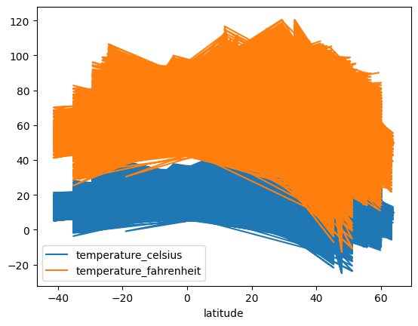
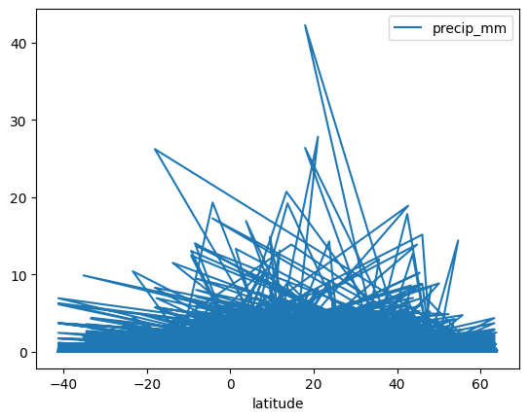
Exploratory Data Analysis (EDA)
Temperature Trends (Celsius vs. Fahrenheit)
Precipitation Trends
Insight: Strong linear corelation (expected)
Insight: Sporadic rainfall events

Slide 5
Model Setup
Algorithm: Ridge Regression (alpha=0.1).
Train-Test Split:
Training: First 35 rows.
Testing: Rows 36+.
Features: All 12 weather parameters (e.g., humidity, wind speed).

Slide 6
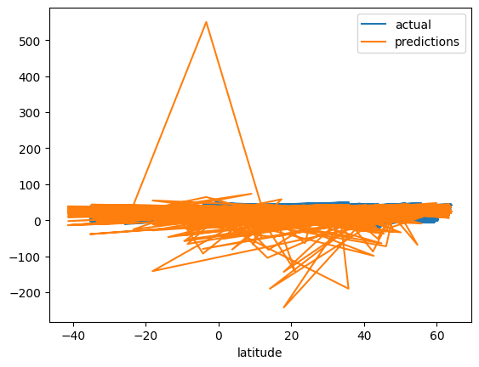
Model Evaluation
Mean Absolute Error (MAE)
Actual vs. Predicted Temperatures
Result: 8.585383009399957
Insight: Model tracks genral trends but may miss outliers

Slide 7
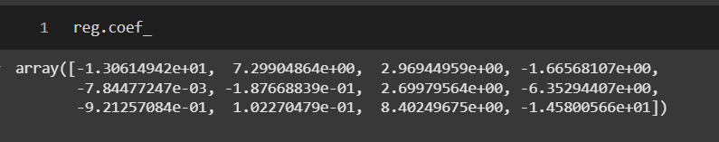
Feature Importance
Ridge Regression Coefficients

Slide 8
Limitations
Data issues
Model issues
Latitude as index (not time-series)
Small training size (35 samples)
Linear assumptions (ridge regression)
Skipped rows during train-test split.

Slide 9
recommendations
Data Improvements:
Use datetime index for time-series alignment.
Handle missing values (imputation).
Model Improvements:
Test ARIMA, LSTM, or Gradient Boosting.
Cross-validation for robustness.

